Slide 1

Department of Information Technology
A.P. Shah Institute of Technology
G. B. Road, Kasarvadavli, Thane (W), Mumbai - 400615
UNIVERSITY OF MUMBAI
Academic Year 2020-2021

Slide 2
A Project Report on
Monitoring Health of IIoT Devices using Blockchain
Submitted in fulfillment of the degree of
Bachelor of Engineering (Sem-8)
in
INFORMATION TECHNOLOGY
By
Rutuja Patole (17104011)
Rushika Ramane (17104064)
Soundarya Nevrekar (17104066)
Under the Guidance of
Prof. Anagha Aher & Prof. Neha Deshmukh

Slide 3
1.Project Conception and Initiation

Slide 4
1.1 Abstract
This project aims to create a reliable method for secure information transfer industrial wireless sensor networks by monitoring IoT devices through blockchain technology.
The vital component of the blockchain, immutability, carries protection from unapproved alterations.
Our project elaborates on monitoring the organization data and the idea is dependent on blockchain innovation.

Slide 5
1.2 Objectives
Monitoring: The monitoring module can detect status change of target device and send alert messages to the administrator.
Security: To ensure the security of blockchain network, so as to prevent the system from being tampered by unauthorized users.
Scalability: To achieve scalability by storing data on the cloud server.
Accuracy: To ensure the accuracy of the monitoring module, and to eliminate false negatives that have a bad impact on the system.

Slide 6
1.3 Literature Review
Blockchain-based Status Monitoring System {BoSMoS} published by Sen He, and Wei Ren, Tianqing Zhu, Kim-Kwang, Raymond Choo
The framework is intended to track the software status of IIoT computers, identify and respond to detected malicious actions (e.g. intrusions). BoSMoS takes a snapshot of the tracked software's current state and tracks their file system calls.
Benefits: Ledger will be the system of record for the business - Transactions (asset transfer) and Contracts (conditions for a transaction to occur).
Drawbacks: The entire system may be malfunctioning, communication can be faulty

Slide 7
1.3 Literature Review
Tornado Enabling Blockchain in Heterogeneous Internet of Things through A Space-Structured Approach (2020) published by Yinqiu Liu, Kun Wang, Kai Qian, Miao Du, and Song Guo
A high-performance blockchain architecture built on a space-structured ledger and corresponding algorithms to allow blockchain in IoT. To increase network scalability, we first create a space-structured chain architecture with novel data structures.
Benefits: Enhanced connectivity with partners, customers, suppliers.
Drawbacks: Differentiated mining difficulty, Parallel workflows.

Slide 8
1.3 Literature Review
Towards Secure Industrial IoT: Blockchain System with Credit-Based Consensus Mechanism (2019) published by Junqin Huang, Ling Kong, Guihai Chen, Min-You Wu, Xue Liu, Peng Zeng
A blockchain system with credit-based consensus mechanism for IIoT provides data authority management system to control access to sensor data to maintain confidentiality.
Benefits: Strengthens the industrial systems with secure data sharing, privacy preserving data aggregation, data confidentiality etc.
Drawbacks: Single point failure, Sybil attack and tampering of data

Slide 9
1.4 Problem Definition
Hackers have already deployed malware to exploit inter connected sensors and gained access to private networks.
Critical threats to their infrastructure because of unauthorised intrusions intending to disrupt, degrade, or destroy systems.
We intend to secure that by creating a reliable product that makes use of Blockchain technology.
Reference:
IoT Technological Development: Prospect and Implication for Cyber stability

Slide 10
1.5 Scope
Planning a reasonable consensus algorithm for this scheme and deploying the amplified framework in reality.
A world of large scale industrial collaborations where substantial amounts of data can be processed safely is envisioned.

Slide 11
1.6 Technology stack
IBM Watson Cloud
IBM Watson Quickstart Virtual Sensor
Node-Red
React.js
MetaMask
Ganache
Truffle Framework
Node.js

Slide 12
1.7 Benefits for environment & Society
The requirement of the market is such that all parties involved in an industry collaboration can rely on a secure system to ensure their interests are being protected.
Corporations from the sectors of energy, water, aviation, and manufacturing are at risk of having their data stolen.
Our aim is to protect smaller scale industries from encountering disaster in their regularly scheduled operations by continuously monitoring activities and making sure that procedures are being carried out as intended.

Slide 13
2. Project Design

Slide 14
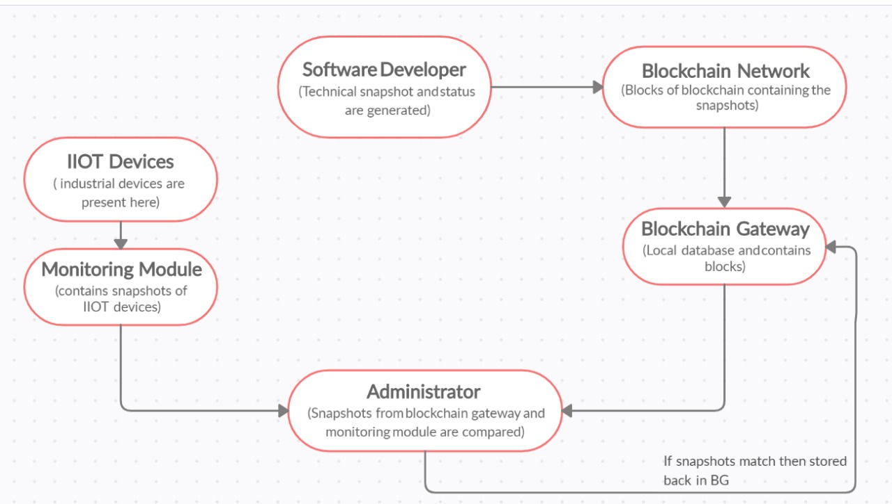
2.1 Proposed System

Slide 15
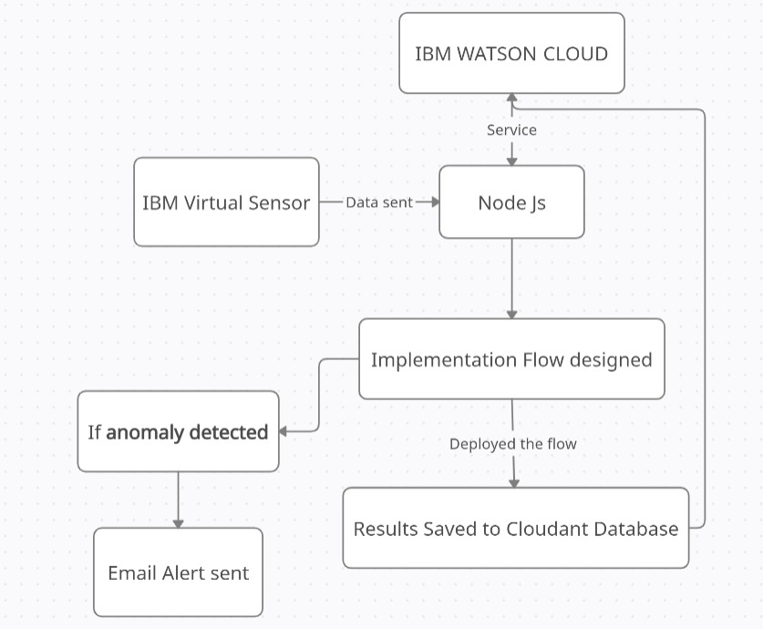
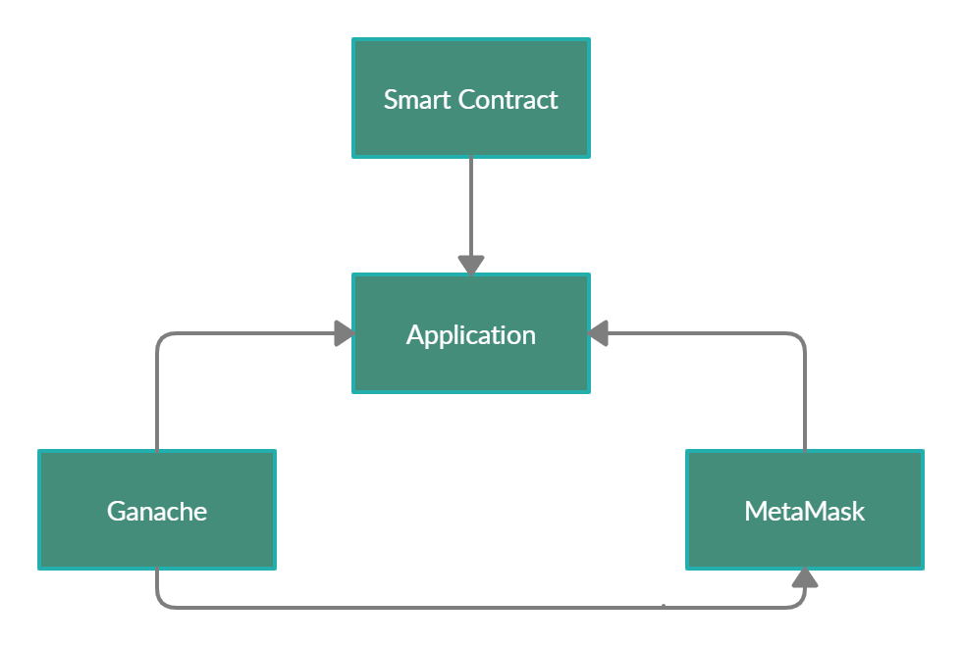
2.2 Design (Flow Of Modules)
Administrator

Slide 16
3. Project Implementation

Slide 17
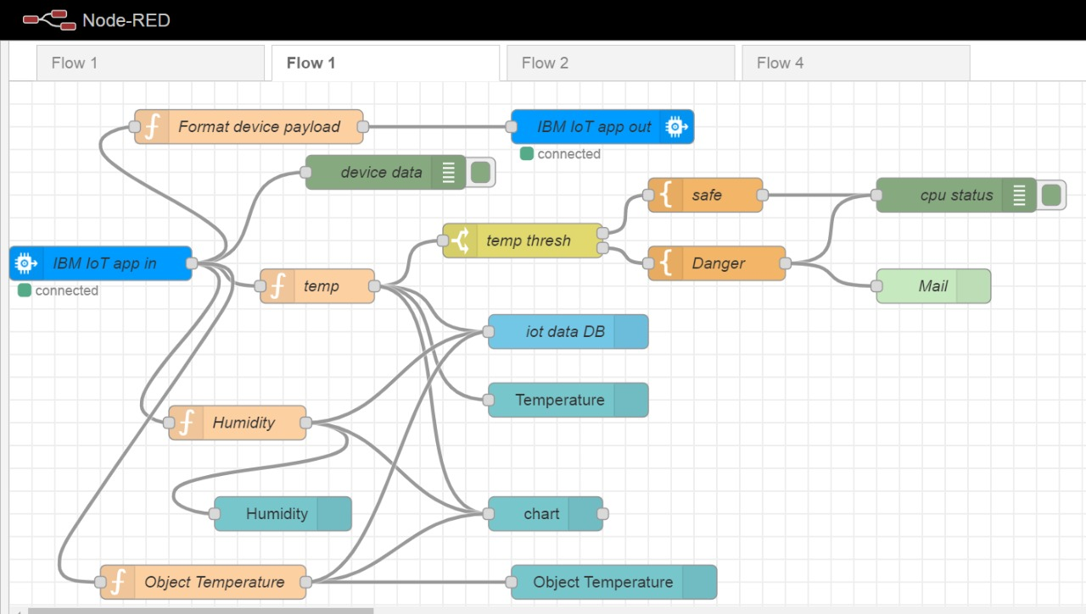
3.1 IIoT Module

Slide 18
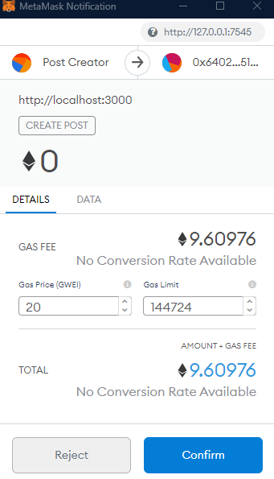

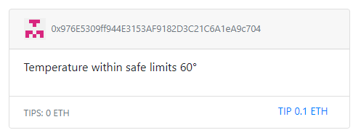
3.2 Blockchain Module

Slide 19
4. Conclusion and Future Scope

Slide 20
Conclusion & Future Scope
This project intends to make a way for IoT devices to achieve industrial-grade accuracy.
Blockchain allows information transfer from remote sensing systems to AI systems using blockchain technologies.
Future expansions incorporate planning a reasonable consensus algorithm for this scheme and deploying the amplified framework in reality.

Slide 21
Paper Publication
Paper entitled “Monitoring Health of IIOT Devices using Blockchain” is presented at the IEEE International Conference on Intelligent Engineering and Management (ICIEM 2021) by Rutuja Patole, Rushika Ramane, and Soundarya Nevrekar.

Slide 22
3.3 References
Blockchain-based Status Monitoring System {BoSMoS} published by Sen He, and Wei Ren, Tianqing Zhu, Kim-Kwang, Raymond Choo
Tornado Enabling Blockchain in Heterogeneous Internet of Things through A Space-Structured Approach (2020) published by Yinqiu Liu, Kun Wang, Kai Qian, Miao Du, and Song Guo
Towards Secure Industrial IoT: Blockchain System with Credit-Based Consensus Mechanism (2019) published by Junqin Huang, Ling Kong, Guihai Chen, Min-You Wu, Xue Liu, Peng Zeng

Slide 23
Thank You

